Slide 1
Borough of Conshohocken Authority 2016 Odor Control Project

Slide 2
The Conshohocken Borough Authority began undertaking an Odor Control Project in spring 2016.
In an effort to keep residents up-to-date with construction and the steps leading to project completion, the Authority is taking and sharing photos to illustrate the progression.

Slide 3
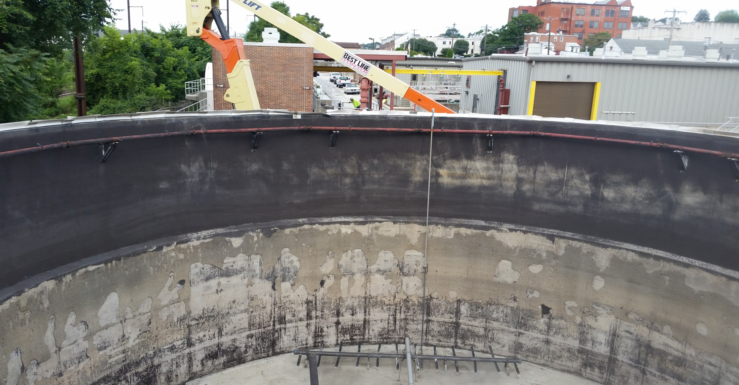
Prep Work
Seen here is a “before” view of the empty tank where contractors are removing the old coating (top portion of tank). The old coating must be removed prior to applying new coating so it can properly adhere to cement walls.

Slide 4
Coating Removal
The old coating must be removed prior to applying new coating so it can properly adhere to cement walls.

Slide 5
Proper Equipment = Time Saved
The contractor rented a lift instead of having to set up scaffolding inside the tank, which saved at least a week of prep work.

Slide 6
Construction Begins
Contractors arrive on site and get ready to start work.

Slide 7
Construction Day 1

Slide 8
Sandblasting Tank 10ft in depth x 50ft in diameter
Contractors sandblast to remove the old material prior to applying the new material.

Slide 9
Sandblasting Continued

Slide 10
Cementitious Coating
After sandblasting the walls cracks formed because of the brittleness inside the tank. Contractors applied a coating first to make it smooth and to make sure the final coat adheres to the tank.

Slide 11
Cementitious Coating
Cementitious coating fills in cracks which resulted from sandblasting.

Slide 12
Cementitious Coating
Seen here in white are portions of the tank following the cementitious coating.
Notes:
Crack repair going down the tank

Slide 13
Crack Repair
An up-close look at crack repair inside the Authority’s tank.
Notes:
Fixing of cracks

Slide 14
First Application of Coating System Protecting Against Corrosive Gases
The new coating is seen here on black portions of the tank. The coating protects the tank from corrosive gas, which could erode and weaken the tank structure.

Slide 15
First Application of Coating System
Contractors coat the wall area 10-ft in depth by 50-ft in diameter using a sprayer manifold system.

Slide 16
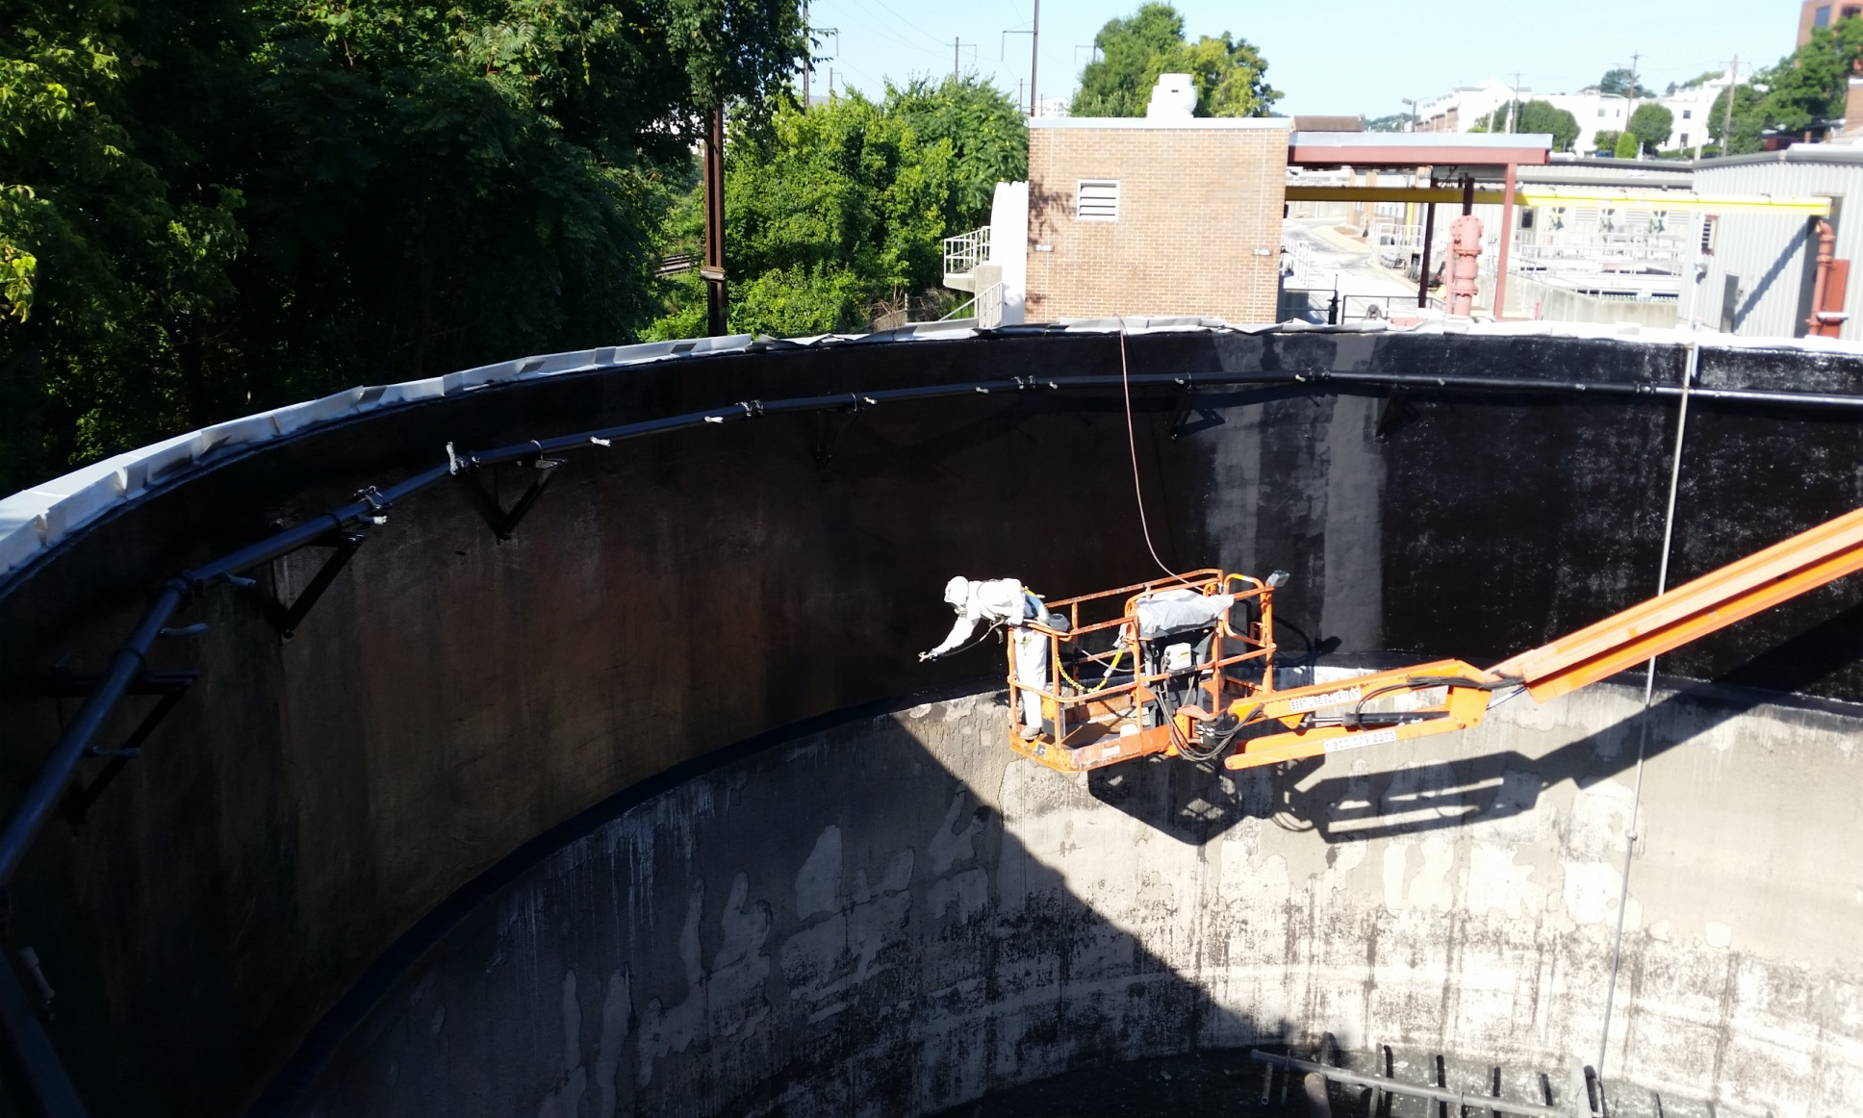
Final Application of Coating System
A worker applies the second application of the coating system.

Slide 17
Final Application of Coating System
A worker applies the second application of the coating system.
Notes:
Two coats. Hand coat and then sprayed

Slide 18
Final Application of Coating System (video)

Slide 19
Digester Tank A
AFTER
BEFORE

